Slide 1


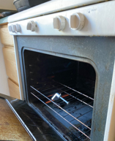
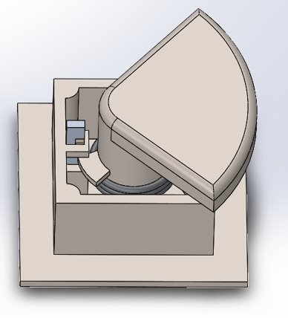
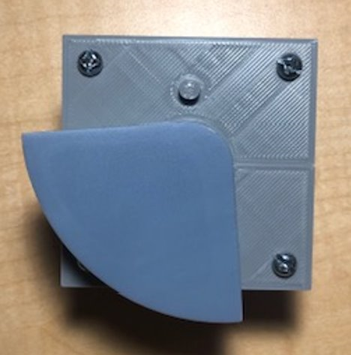
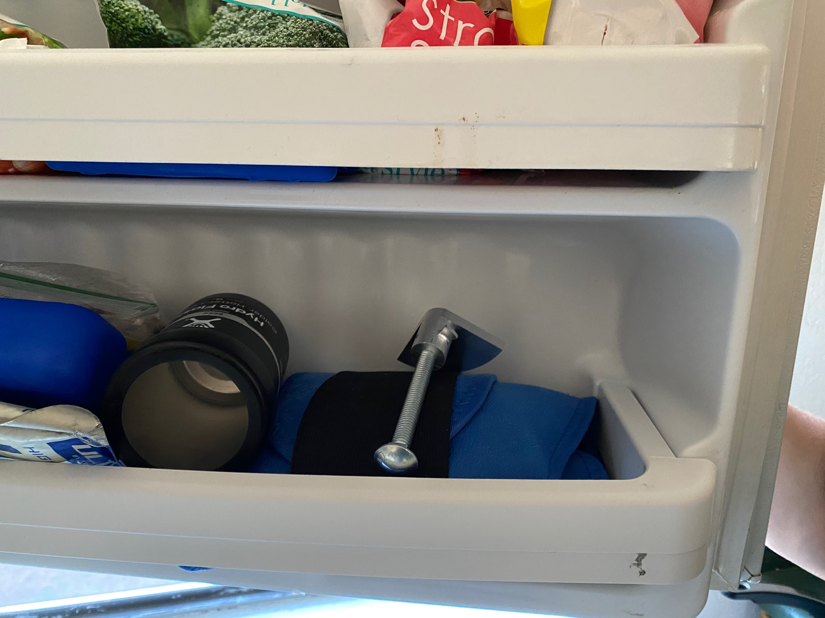
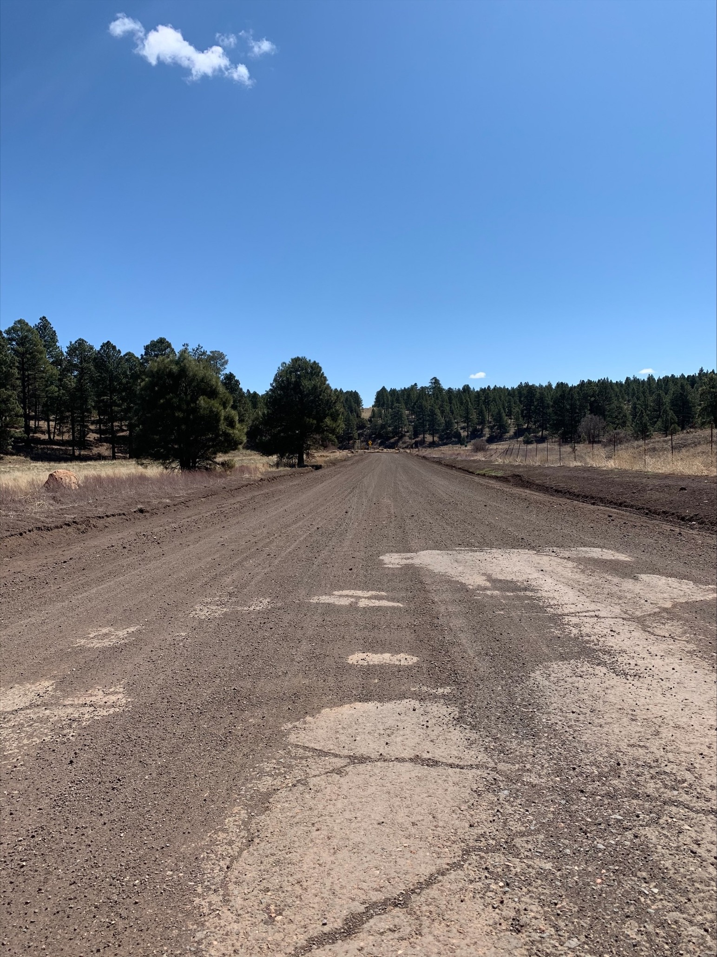
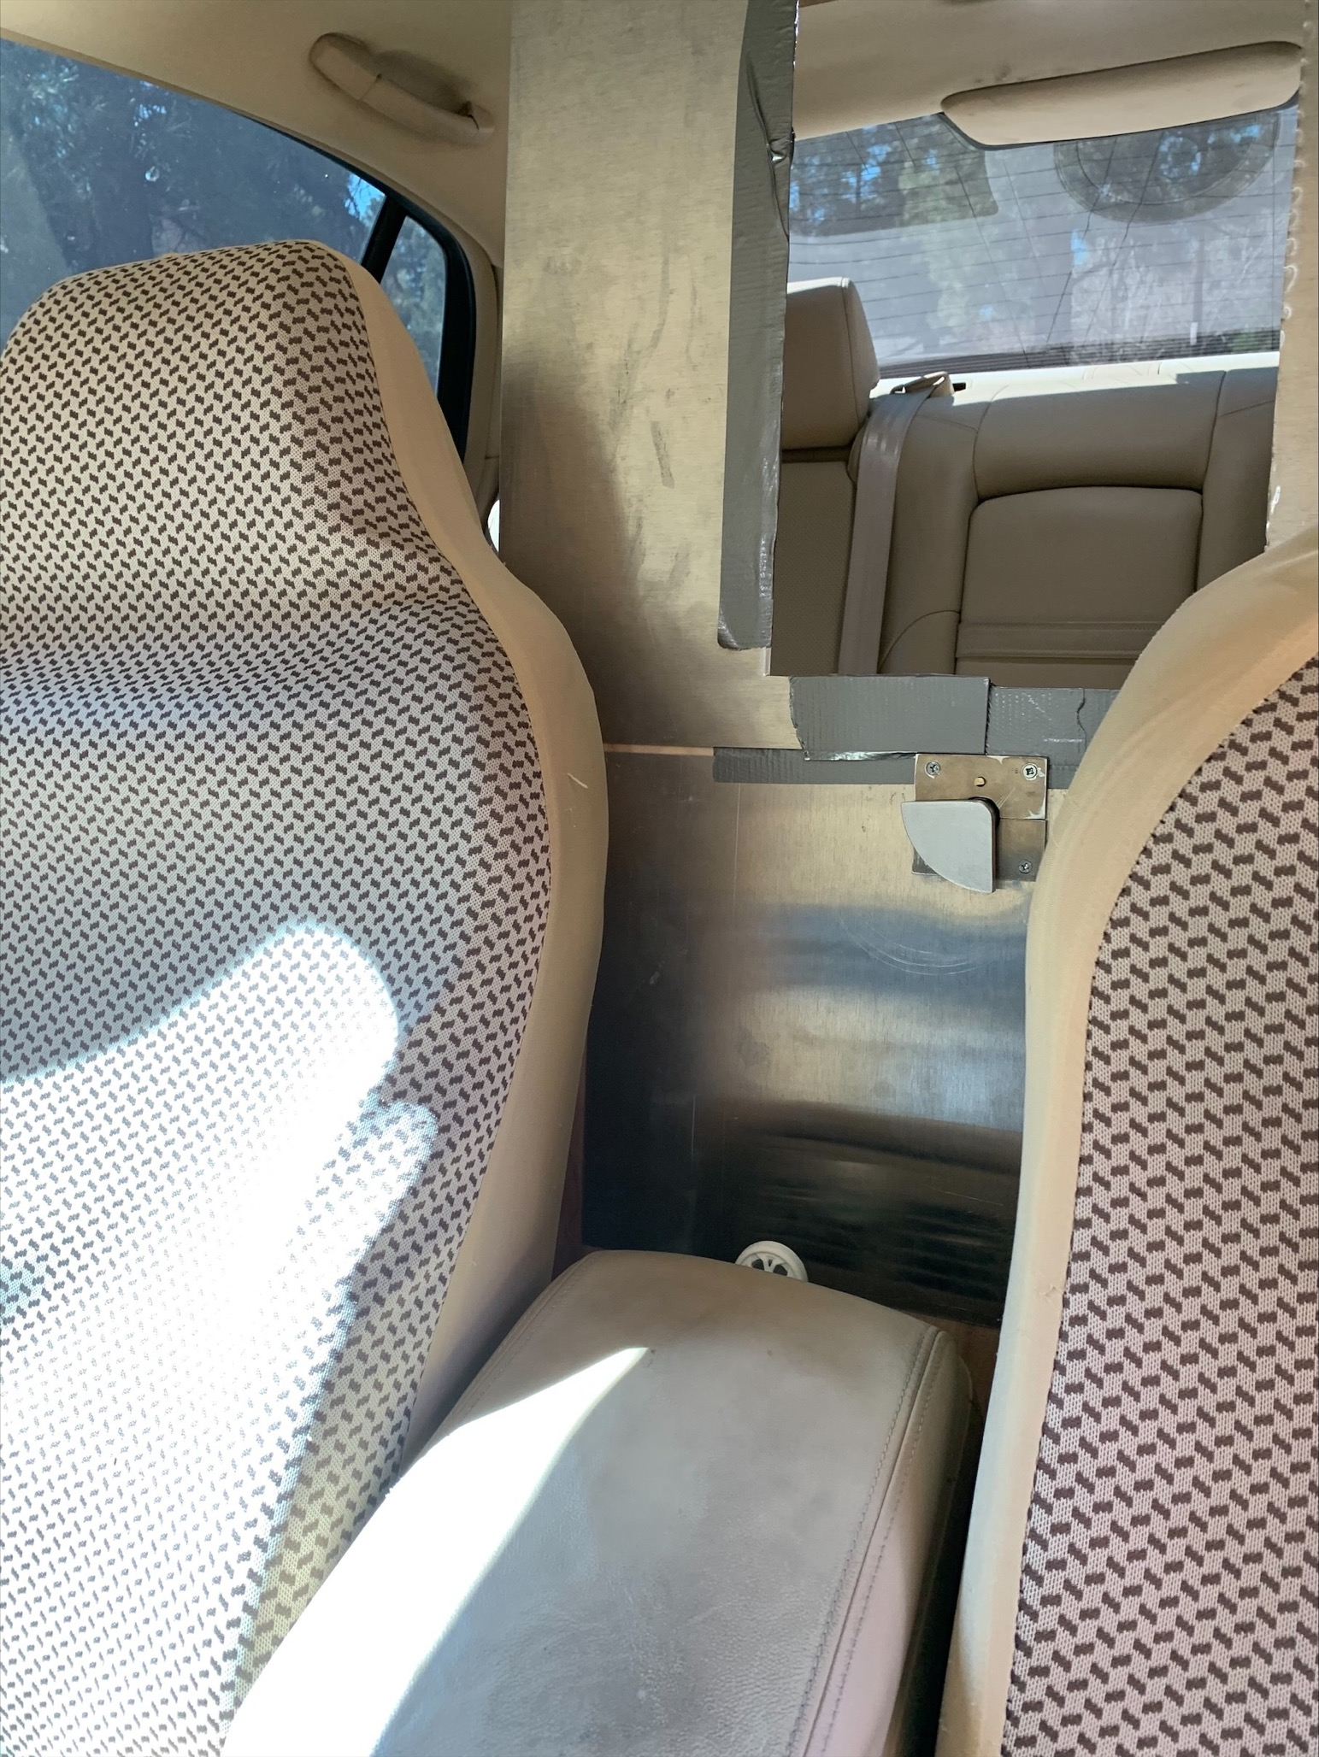
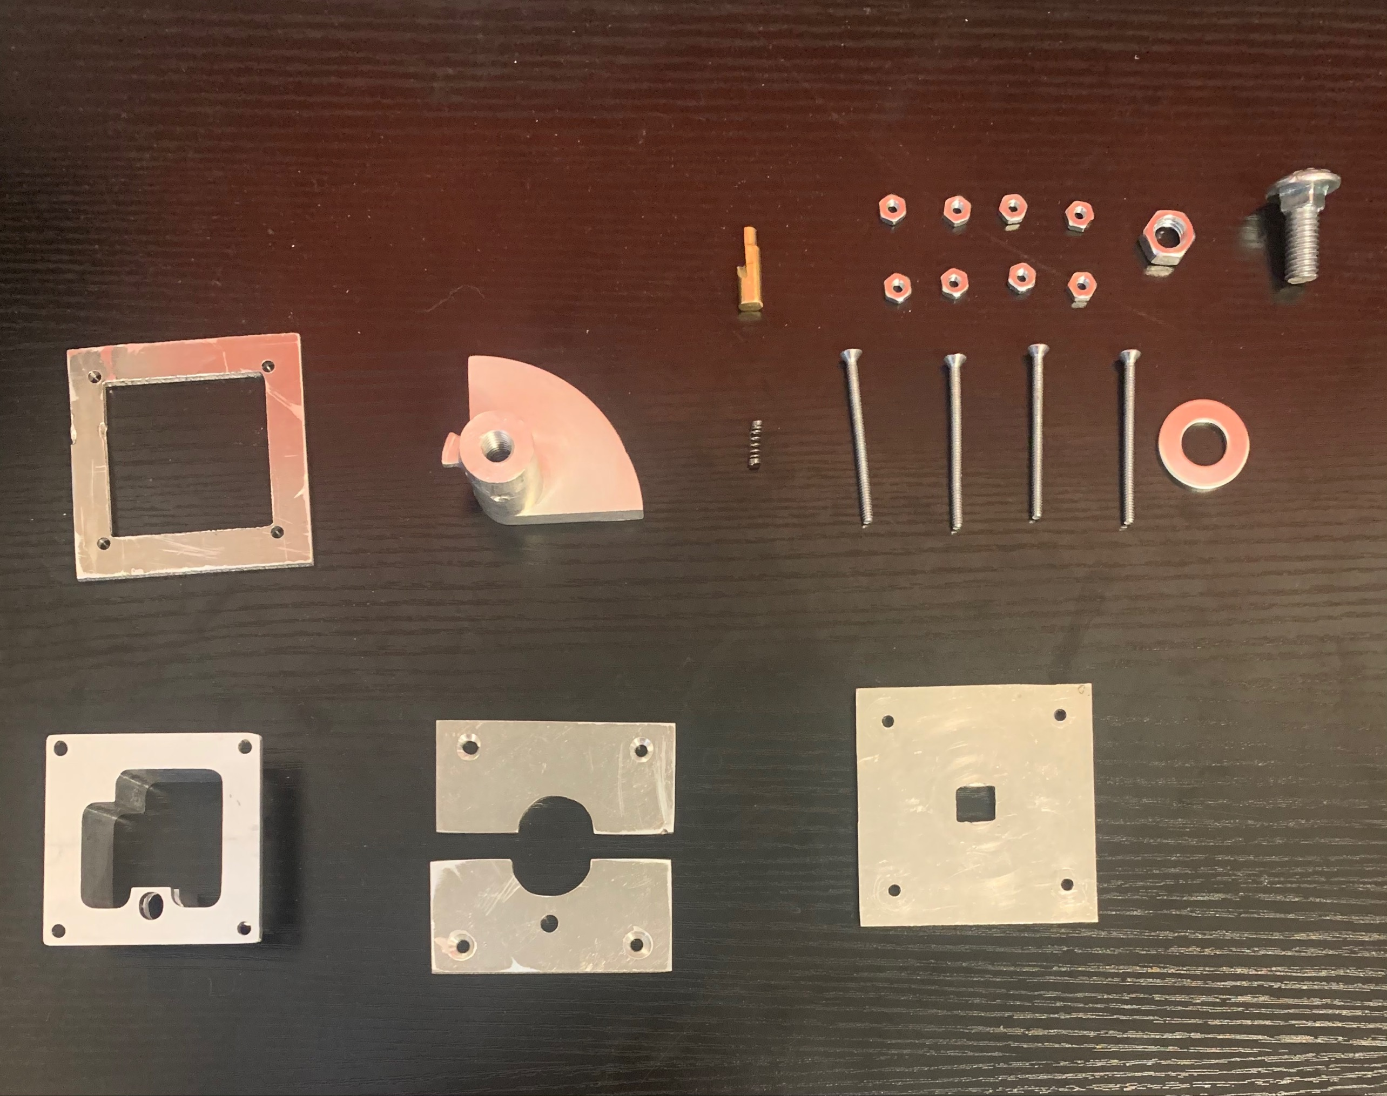
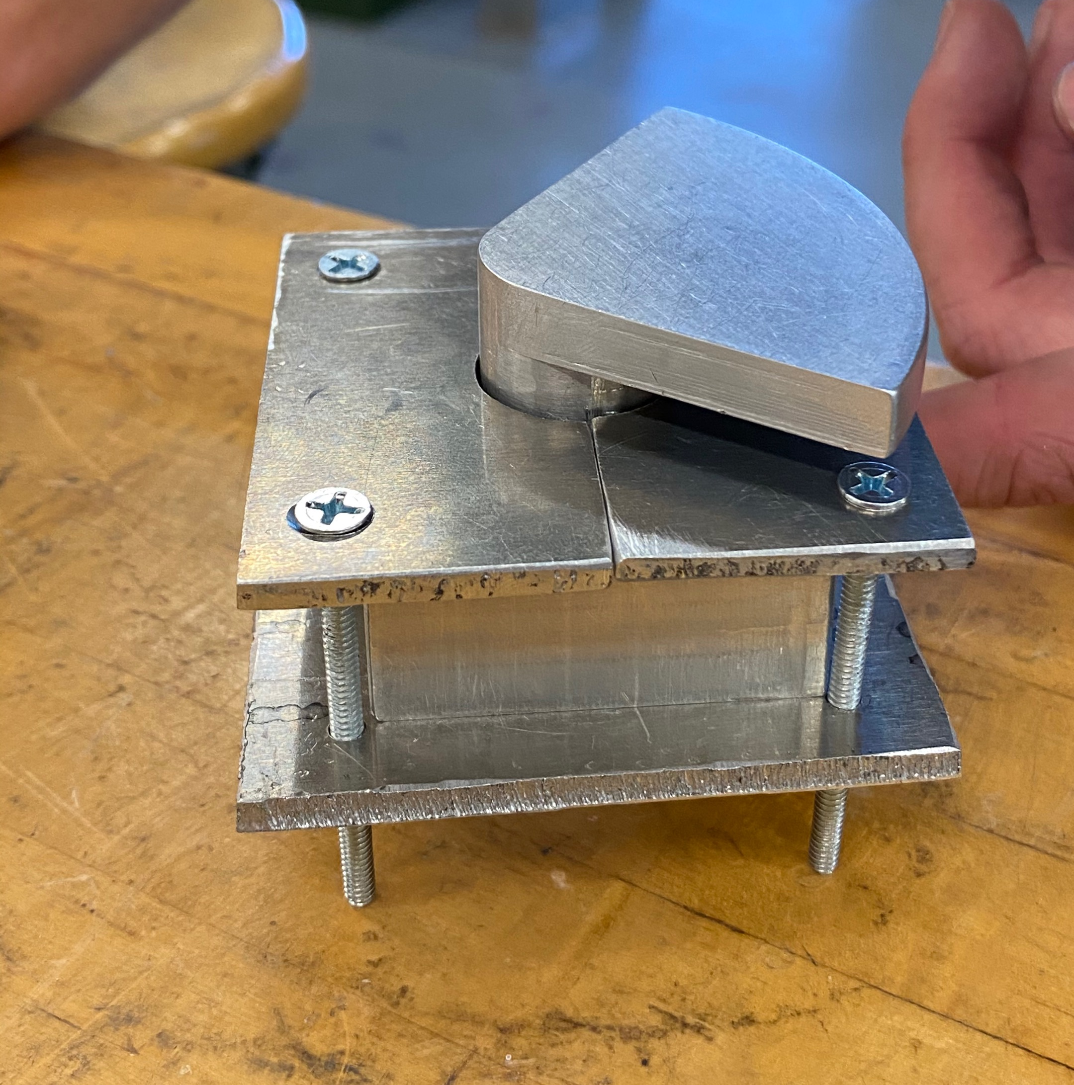
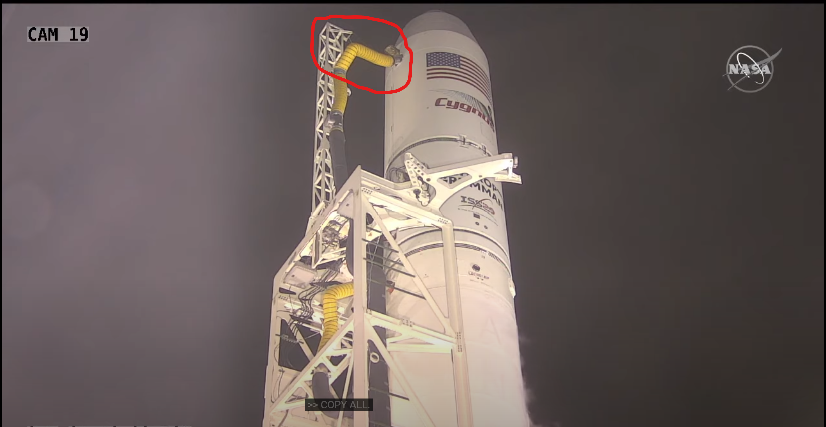
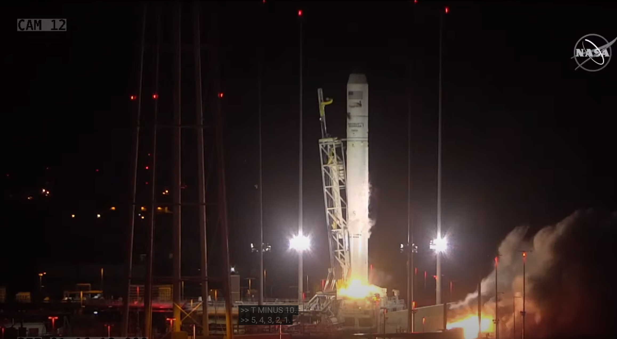
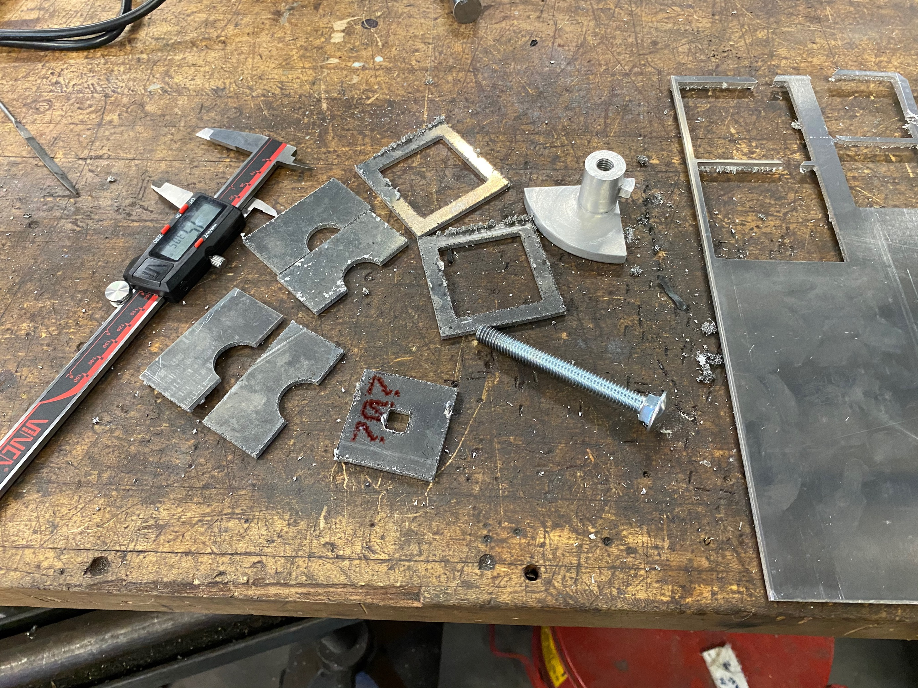
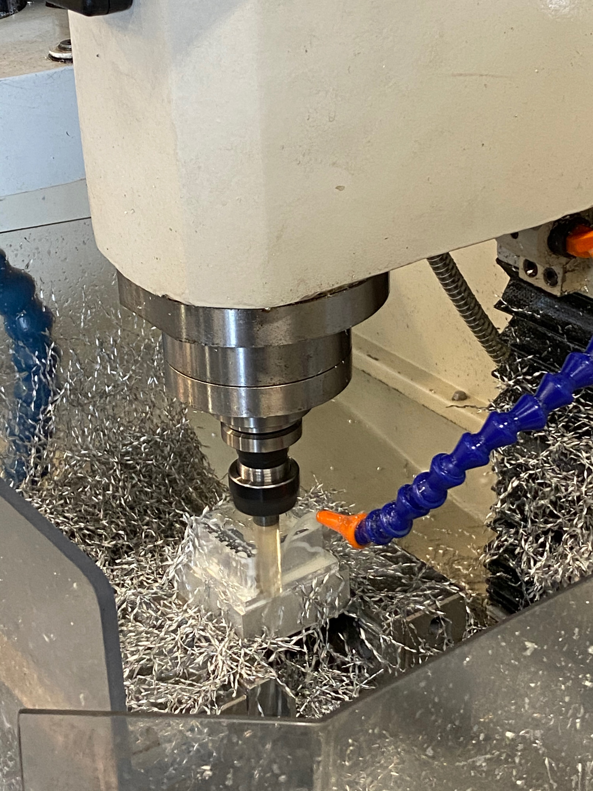
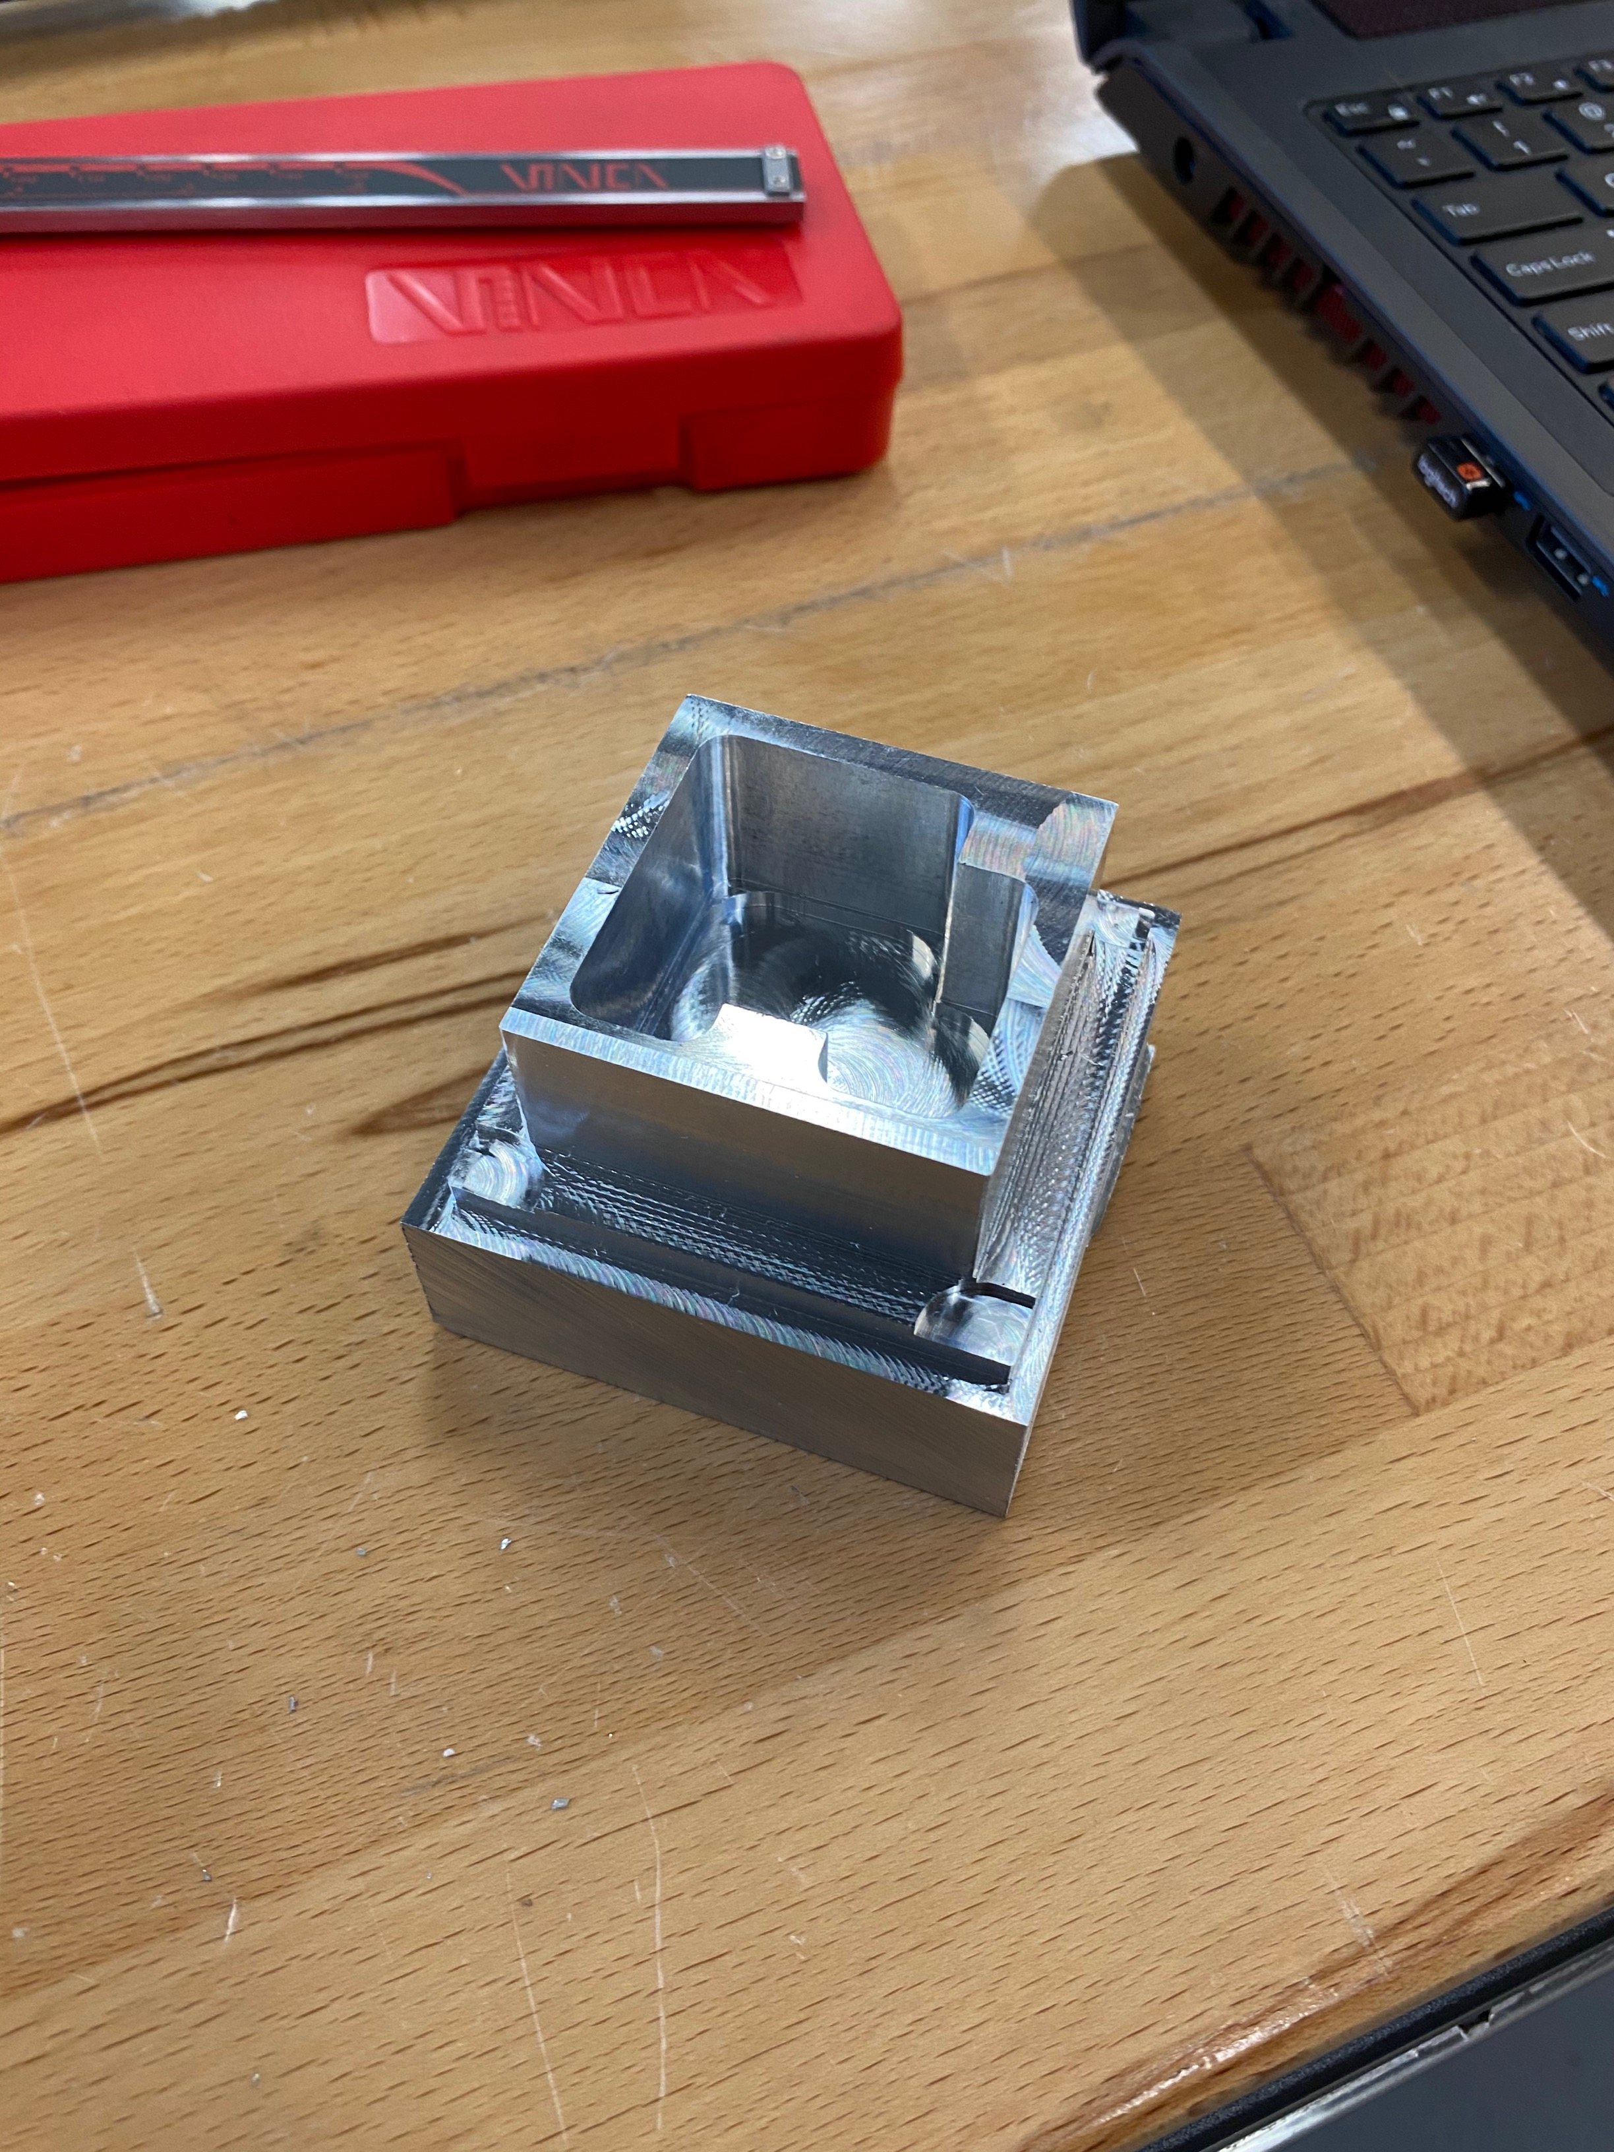
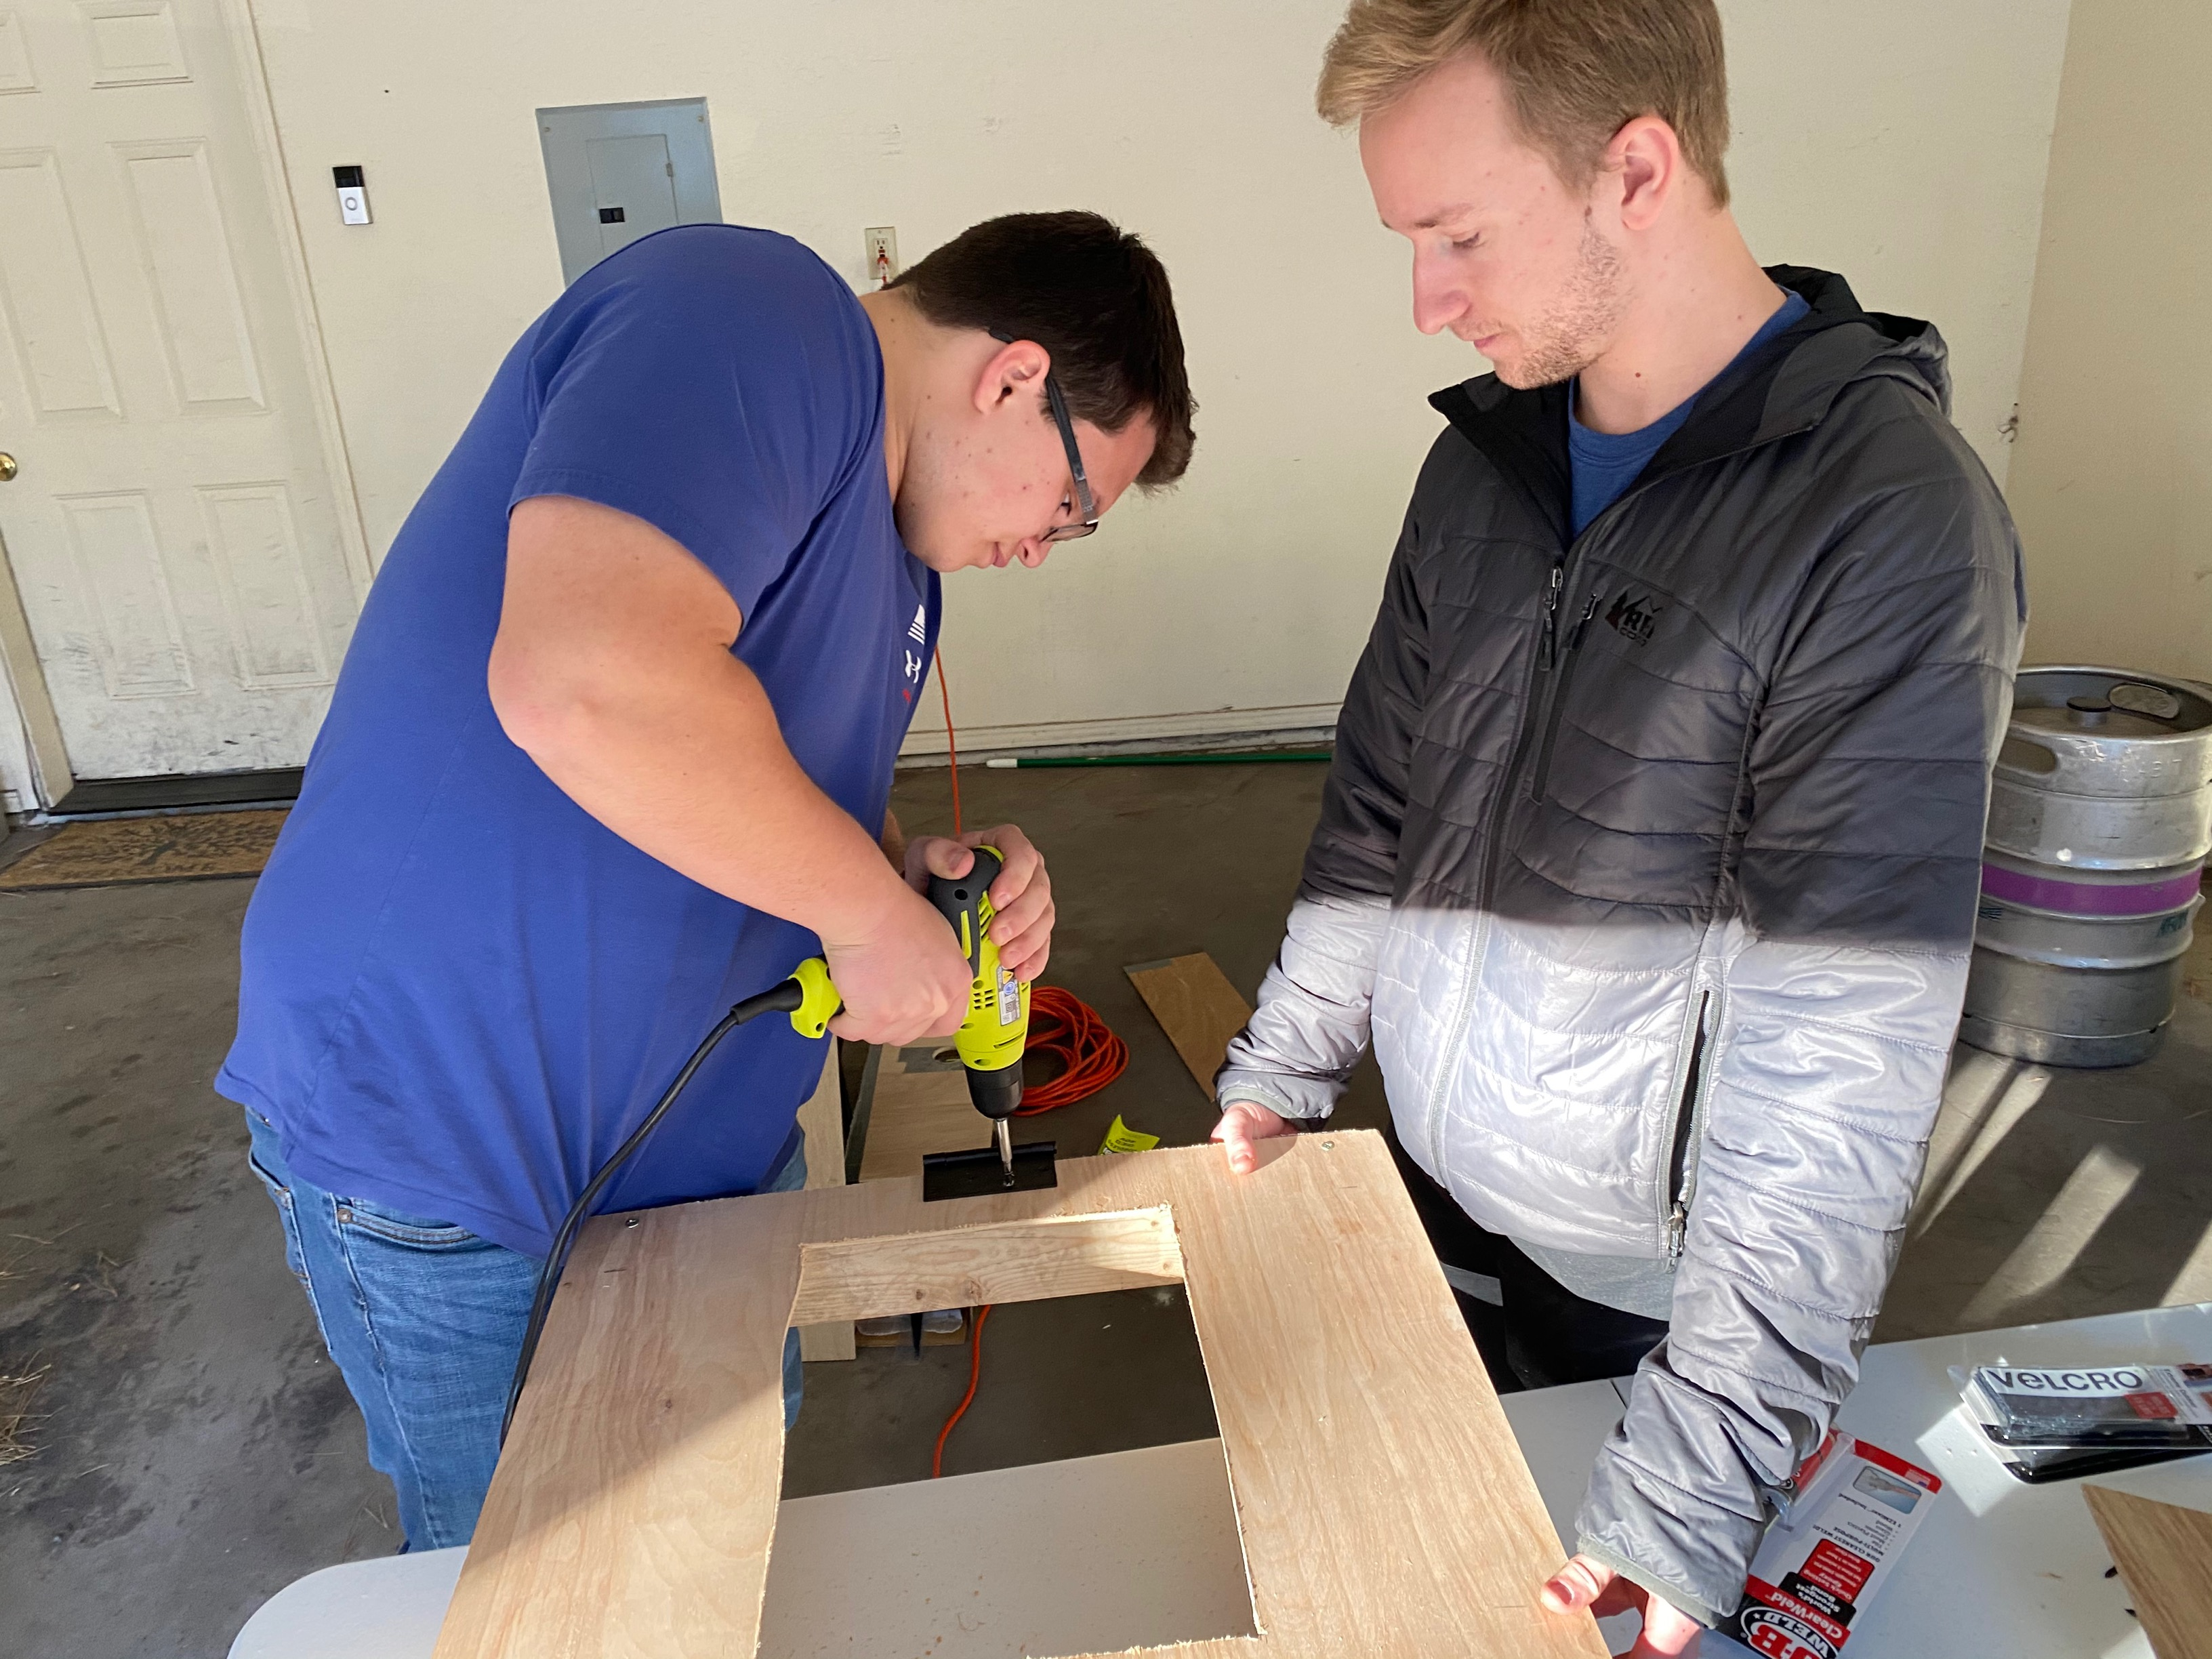
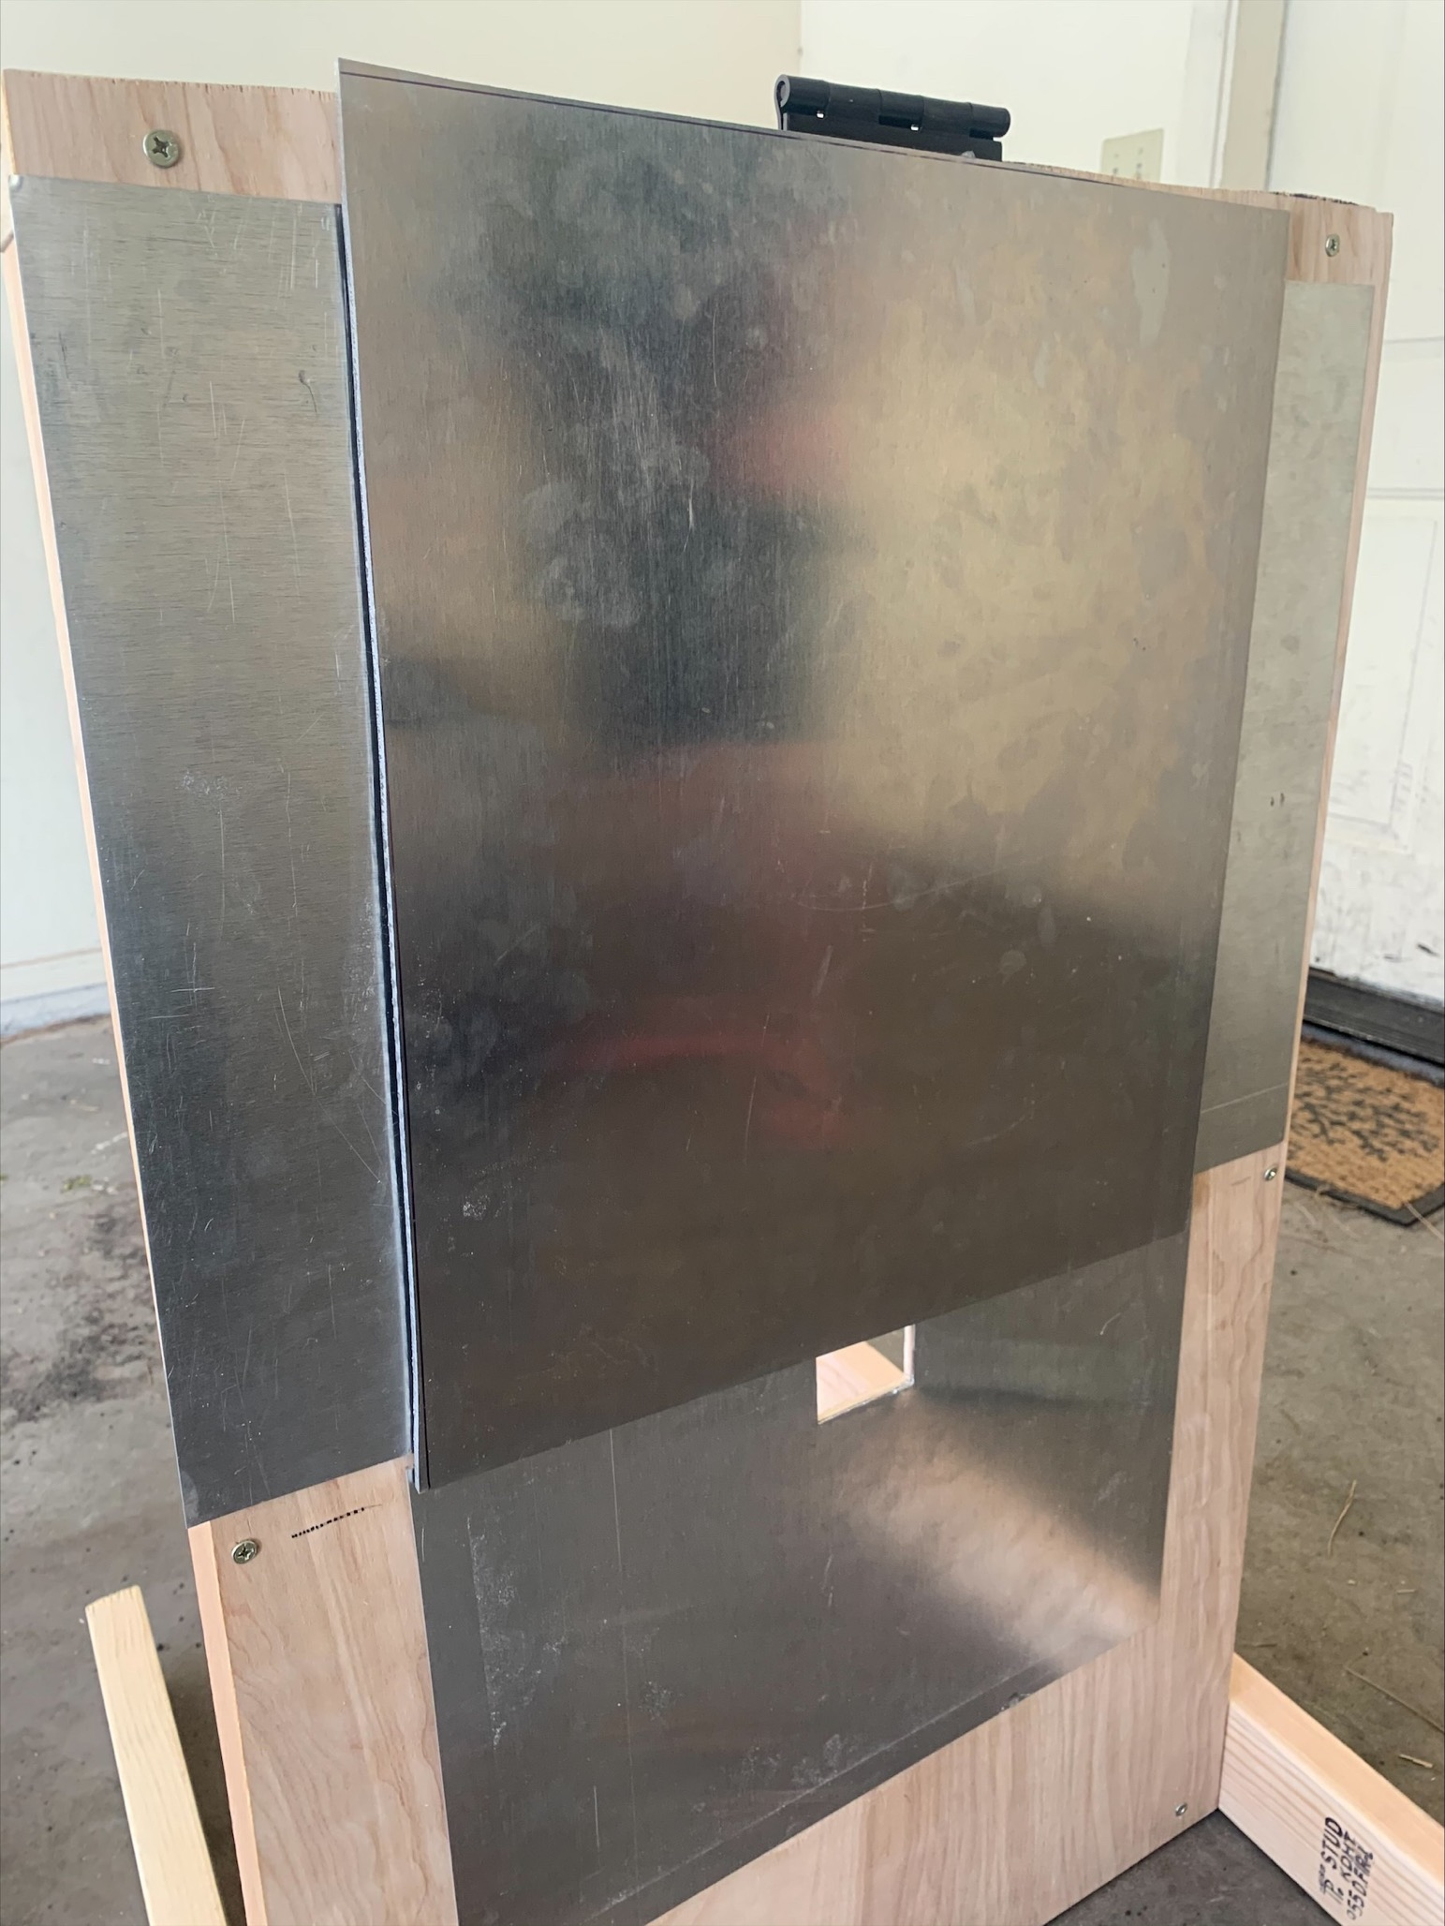
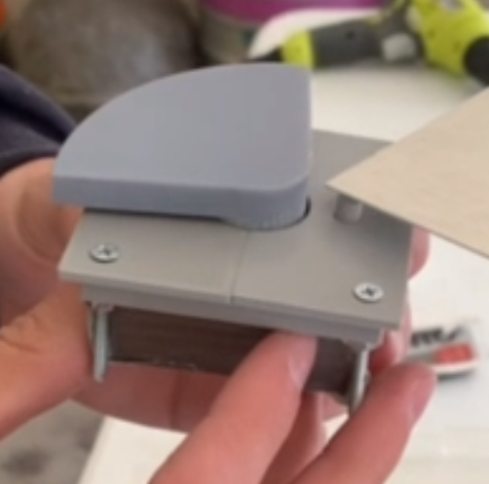
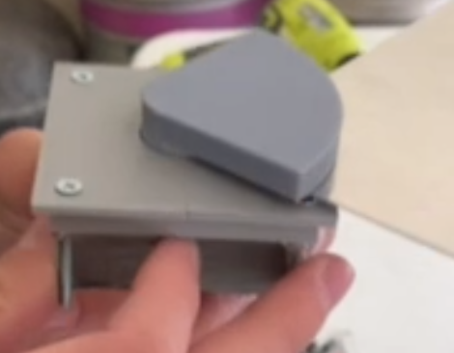
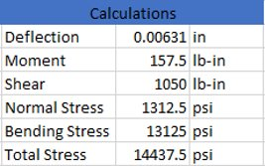
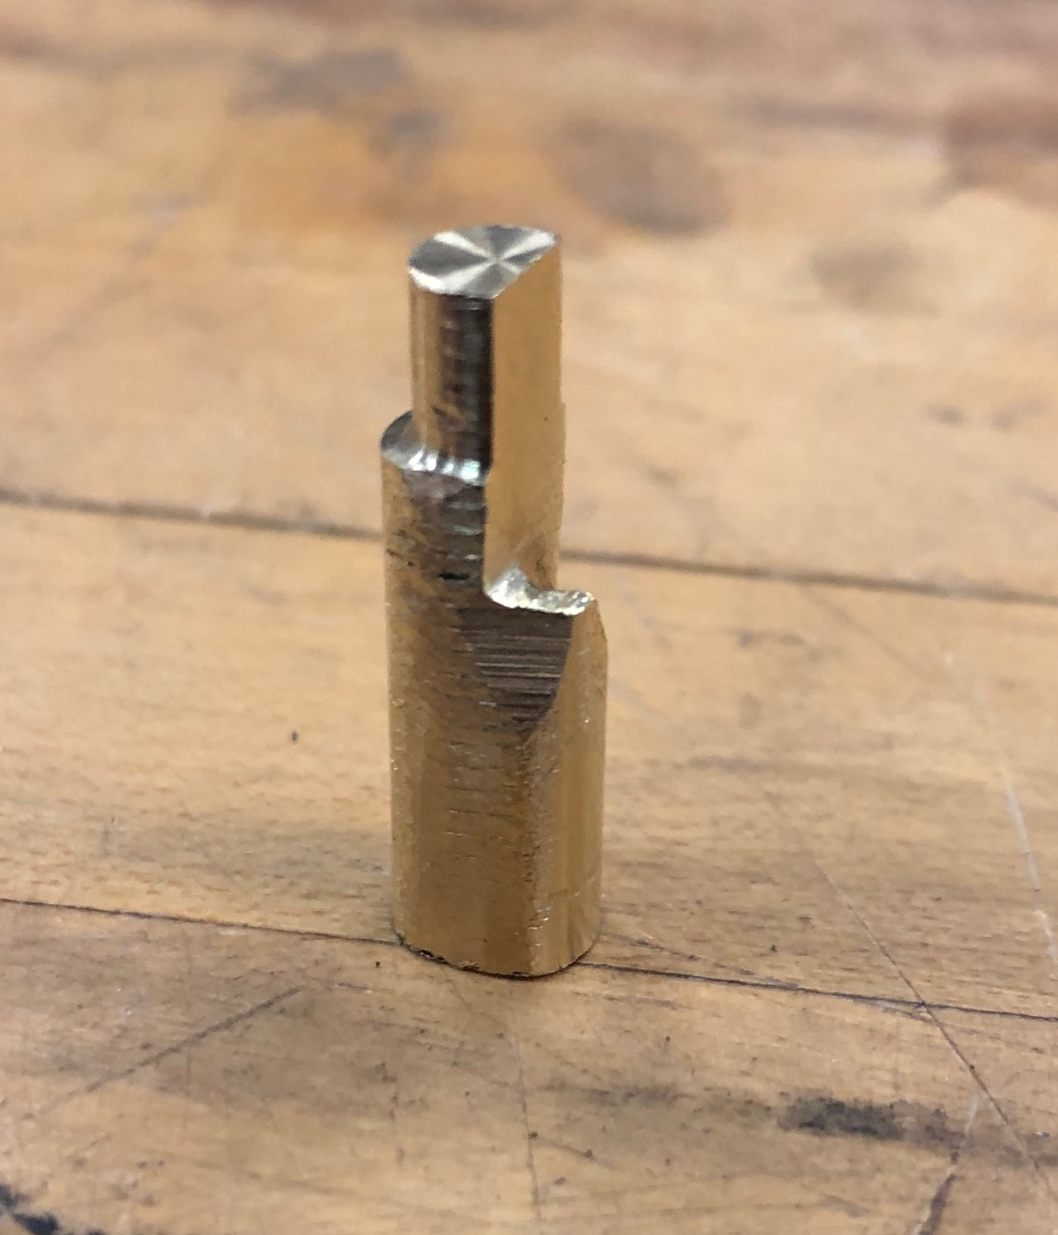
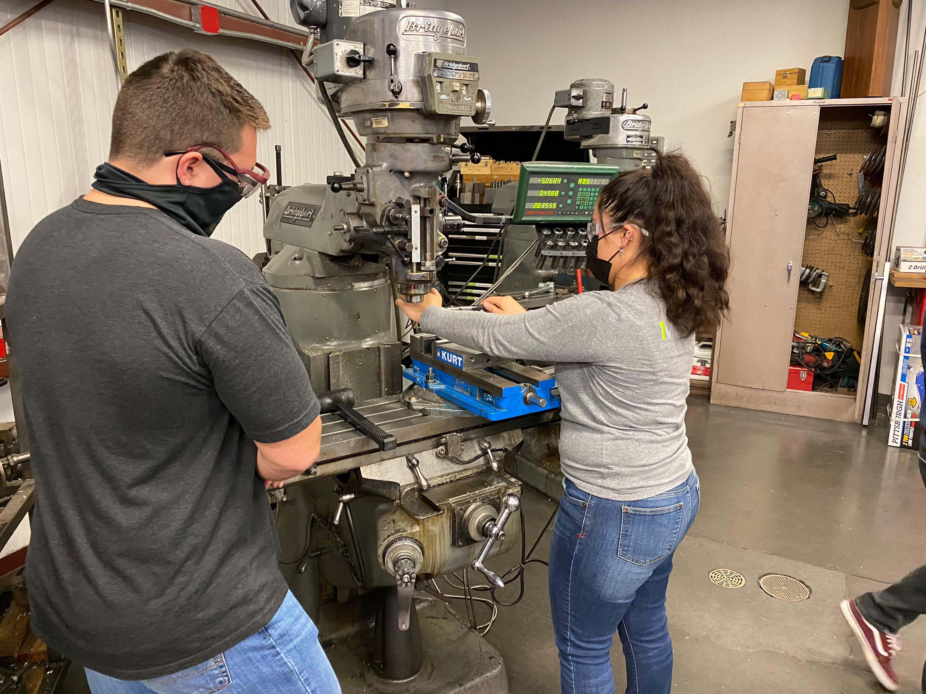
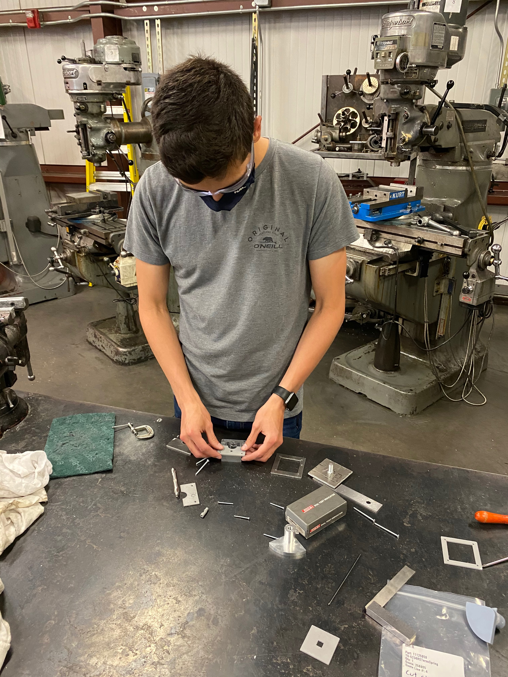
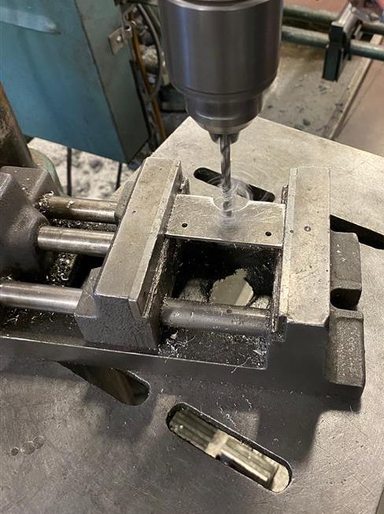

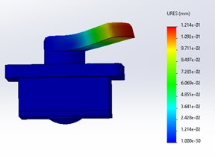
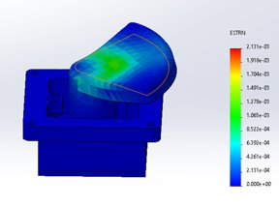
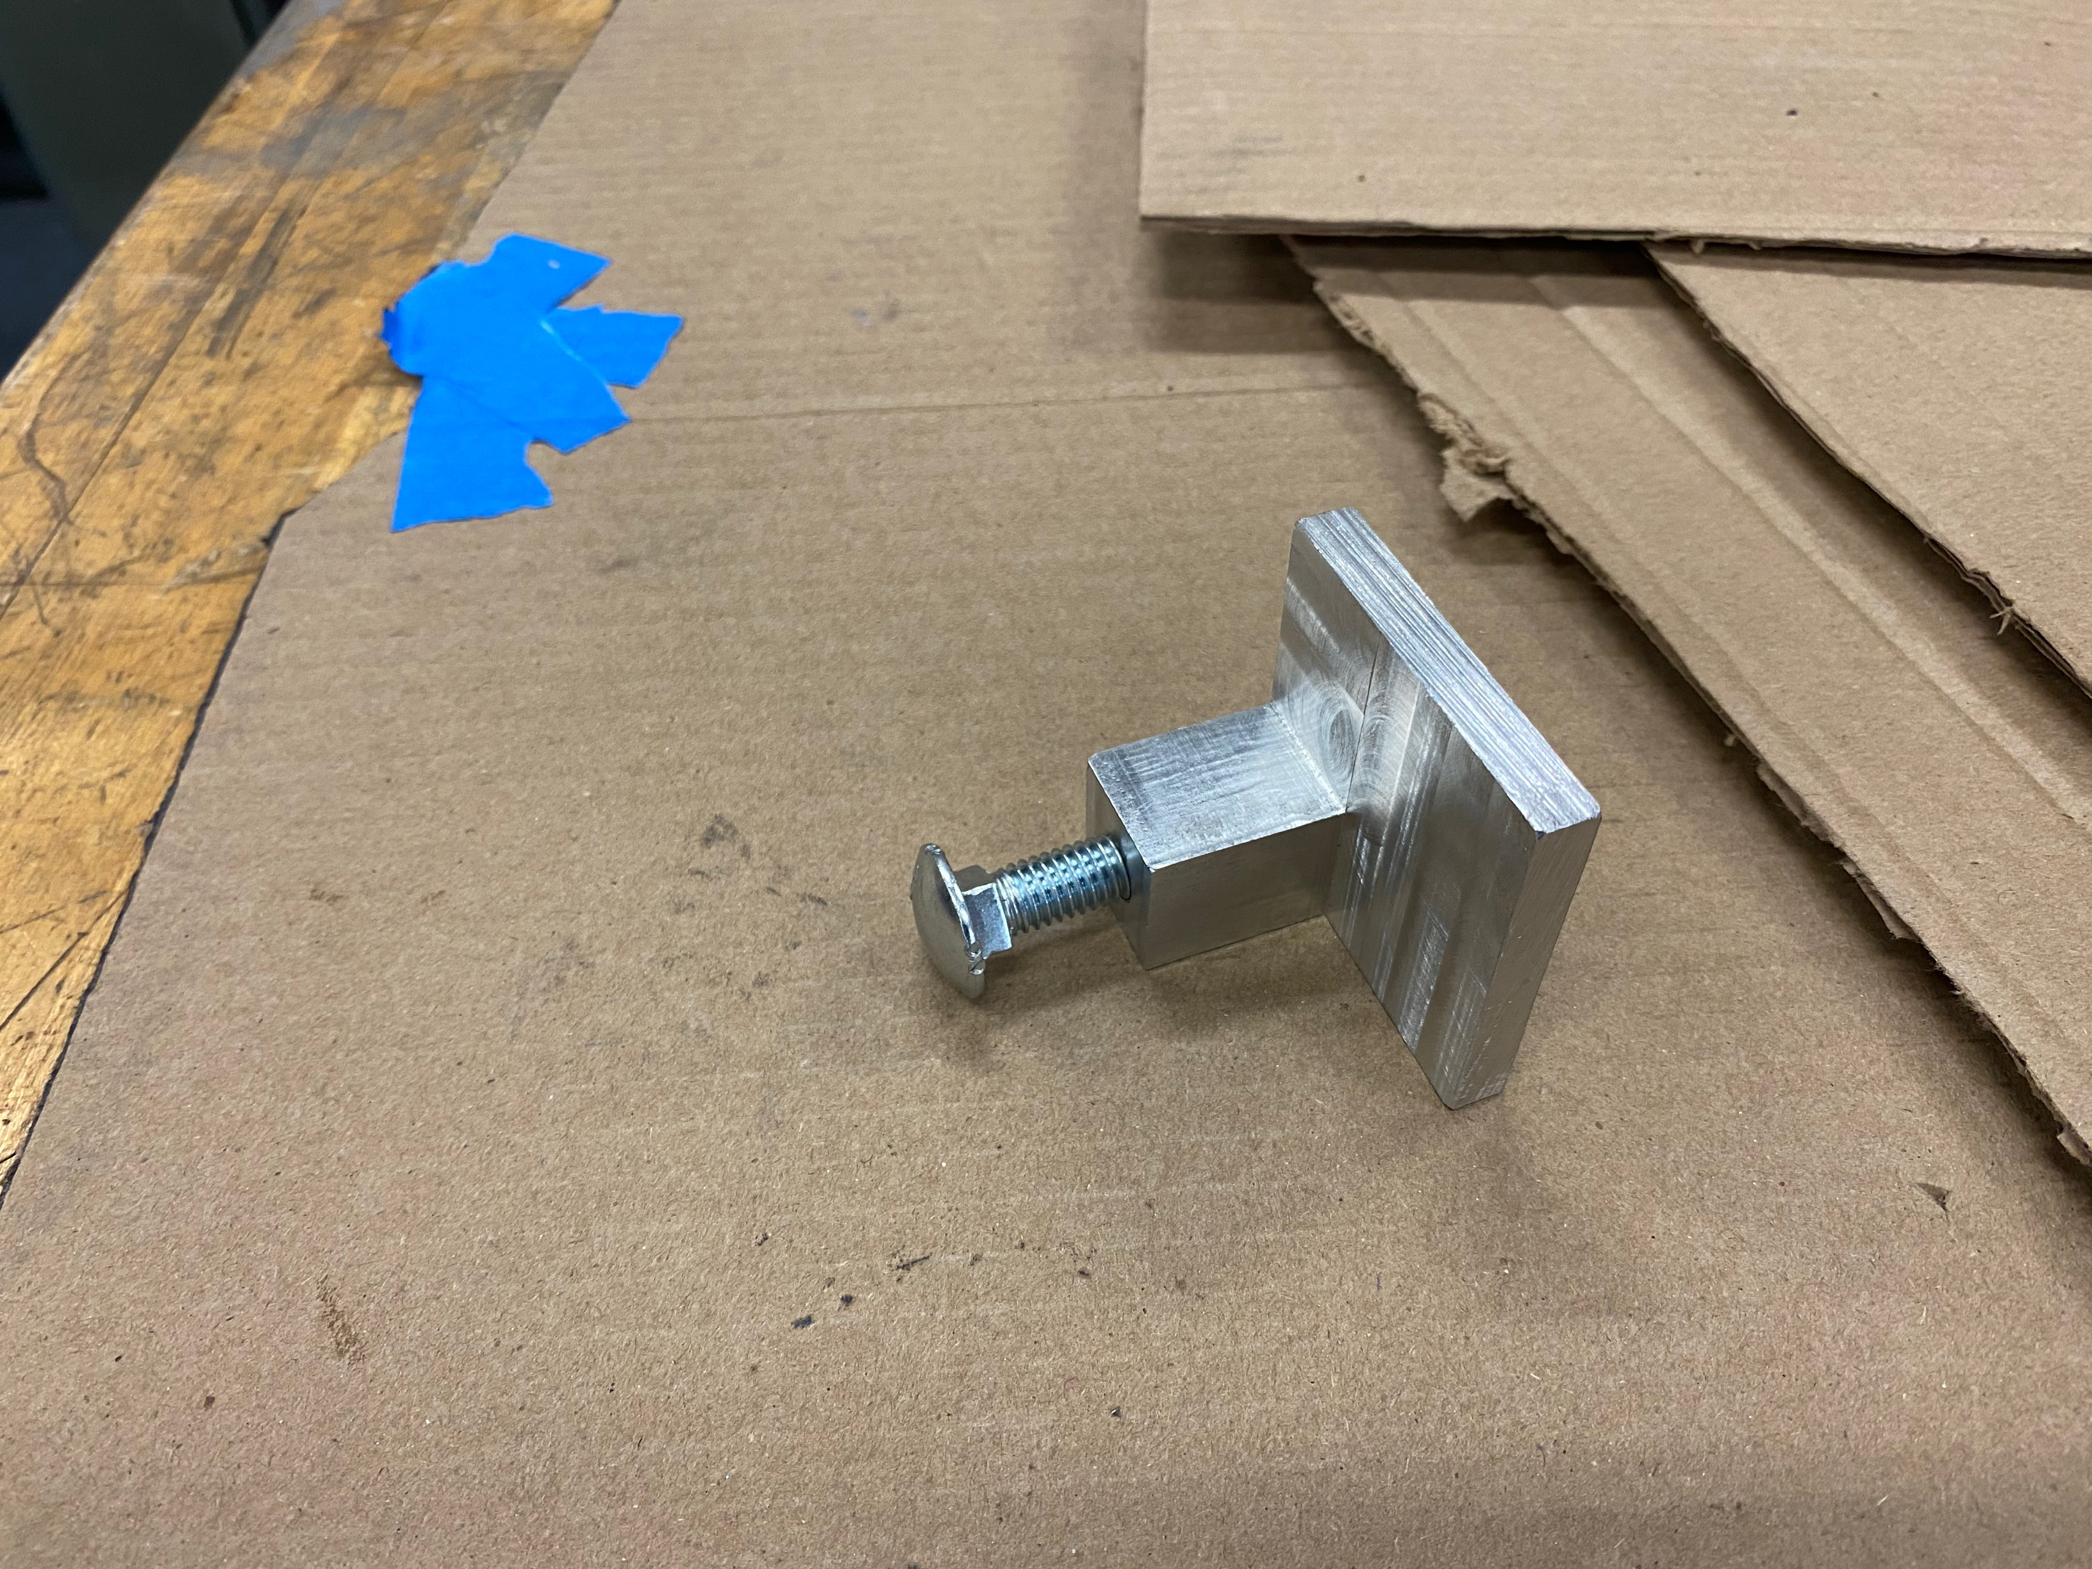
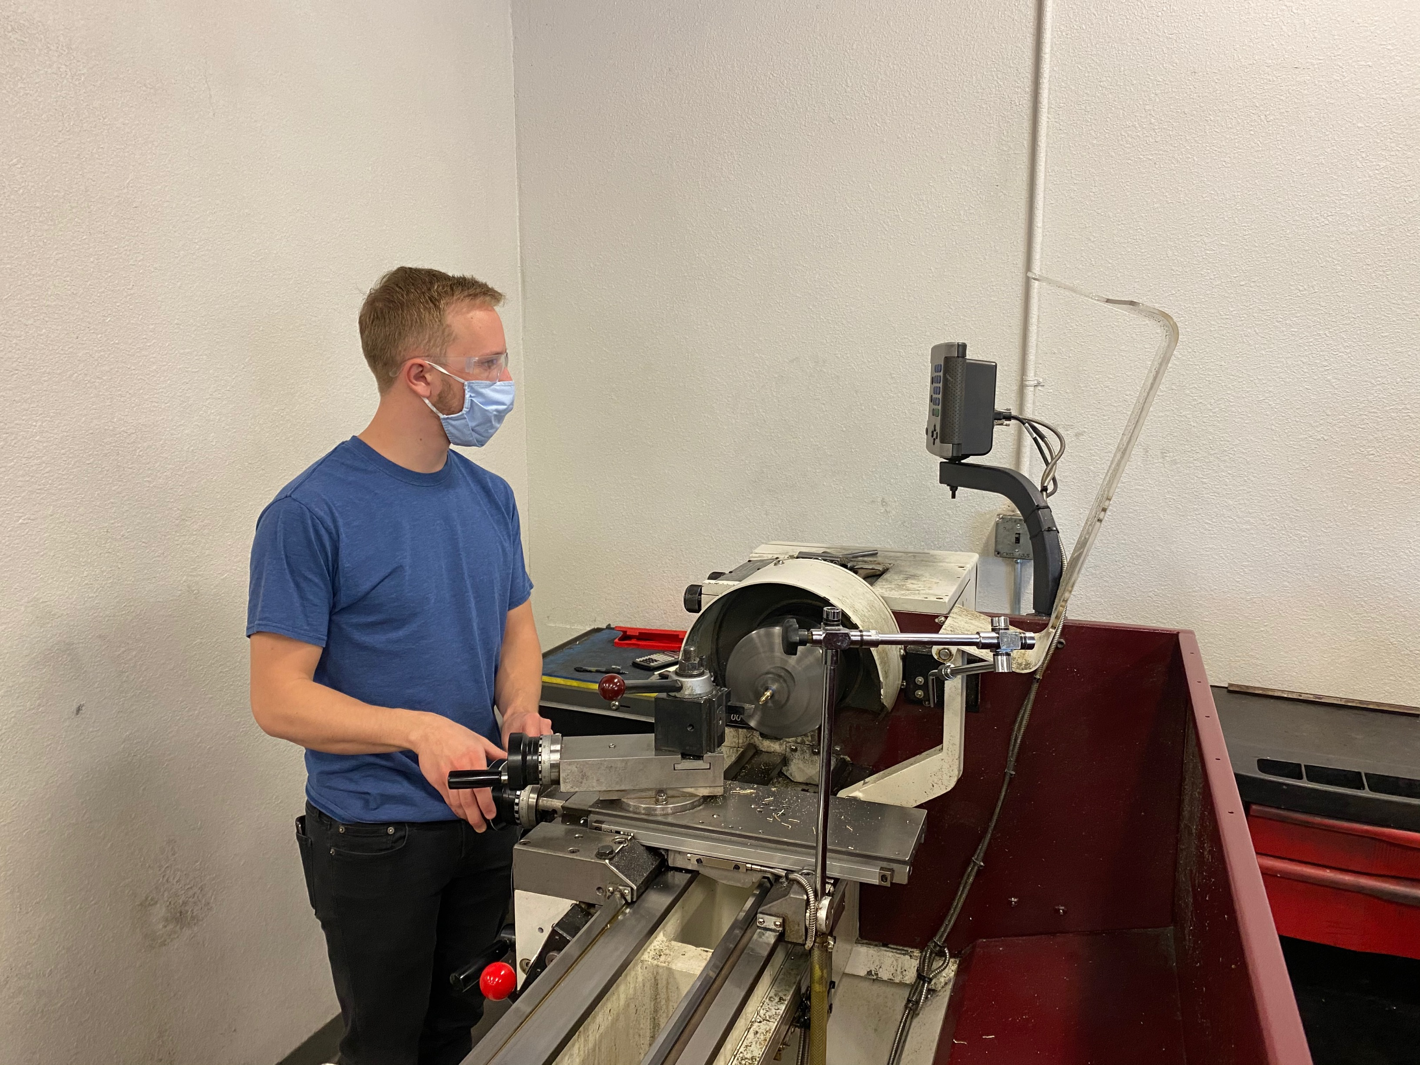
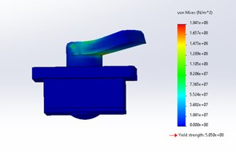
Environmental Control System Door Redesign
Timothy Anderson, Andrea Hernandez, Sam Mangialardi, Alexander Soto, Jake West, Michael Wilson
The Department of Mechanical Engineering, Northern Arizona University, Flagstaff, AZ 86011
Abstract
Design Process
Testing
Most vehicles that Northrop Grumman Space Systems flies have a requirement to keep their payload airconditioned. This air is blown into the fairing through a specific door in the fairings of the vehicle prior to launch. Our team has designed, analyzed, and built a latching system that effectively captures the door to then seal off the inlet for launch. Despite pressure differences, the latch design ensures the door will remain closed throughout the entire flight. The design is light weight while electrostatic discharge (ESD) safe, with features that allow its implementation across the range of flight vehicles for the client from the Antares rocket to fairings as thin as 0.25in.
Throughout the design process, our team wanted to create a latching system that was reliable, lightweight, and can be easily installed into any of Northrop Grumman’s launch vehicles. Various iterations of parts were made using SLA and FDM 3D printing until the team made a functional proof of concept prototype. Once our design was finalized, the team moved on to manufacture a final version of the latching device.
Temperature Test
Temperature test is to check the threading of the shaft and bolt
assembly at various temperatures.
Procedure:
Assemble the mock latch, bolt and screw.
Freeze the assembly for 2-3 hours and remove.
Try to see if the mechanism works as intended.
After, place assembly into an oven to drastically heat it.
Again, see if the mechanism works as intended.
Vibration Test
Testing involved a bumpy road to simulate vibrations on our device.
Functionality Test
This test uses our testing jig to simulate the door closing and our device actuating to keep the door closed.
Currently our 3D printed design was able to operate as planned shown in the Figure below where the latch closes on the mock door.
Introduction
Figure 20: Assembly in the oven
Problem: Antares Door “burps” while in flight.
This means the door failed due to new trajectories during flight. Our solution was to create a device that is:
Scalable
Versatile
Reliable
Our Goal:
Improve the latching system for the Antares rocket.
Investigate potential causes of failures on the door.
A successful design could be implemented into other launch vehicles.
Figure 6: Latching Design V1.0
Figure 7: Proof of Concept Prototype
Final Design
Figure 21: Assembly in the freezer
Figure 22: Test Road for Vibe Testing
Figure 23: Putting Jig in Car
Figure 8: Parts used for Assembly
Figure 9: Assembled Device
Figure 1: Nozzle in place [1]
Figure 2: Nozzle is removed [1]
Manufacturing
Analyses
Thickness of Latch Analysis​
Latch Thickness= .3in​
FS, Yield = 4.37​
FS, Ultimate= 5.07​
FEA
Assumed 1050 lbf on the latch.​
Assumed the shaft would not move due to the top plate restricting movement.​
Max Deformation: 0.01214 mm or 0.000478 in.​
Table 9: Mock Shaft
Figure 10: Laser Cut Sheet Metal
Figure 17: Creating Testing Jig
Figure 24: Testing Jig
Figure 25: 3D Printed Device in Open Position
Figure 26: Closed Position
Figure 13: Using CNC to create mock housing
Figure 15: Mock Housing
Acknowledgements
Sponsors: Advisors:
Daniel Johnson, Kaitlyn Barr, Sarah Oman
Figure 11: Brass pin
Figure 18: Milled mock shaft
References
Figure 14:Measuring Holes for Aluminum Sandwich plates
Figure 16: Drilling holes for Sandwich plates
[1] “Northrop Grumman Cargo Launch to the Space Station from NASA Wallops - YouTube.” [Online]. Available: https://www.youtube.com/watch?v=tQW_2qtBDfY. [Accessed: 12- Oct-2020].
Figure 3: FEA deformation
Figure 4:FEA strain
Figure 5: FEA stress
Figure 12: Mock Shaft
Figure 19: Milled mock shaft

